Slide 1

CALM CONNECT
AI-POWERED EMOTIONAL SUPPORT
TEAM MEMBERS:
SANTHOSH B (221801046)
SRIRAAM GV (221801052)
THOFIQ GANI M (221801057)
MENTOR:
SURESH KUMAR S, Professor

Slide 2

AI Chatbot for Student Mental Health Support
In today’s fast-paced academic world, students face emotional challenges that often go unnoticed. This project introduces an empathetic Calm Connect AI chatbot designed to listen, understand, and support students' mental health. Using Natural Language Processing (NLP) and sentiment analysis, the chatbot detects emotional cues and responds with comforting, context-aware replies. It offers a safe, non-judgmental space accessible anytime, helping students express feelings and seek guidance.

Slide 3


Introduction and Project Motivation
Growing Concern
Project Goal
Support Approach
Students face pressures like deadlines, competition, and personal struggles, often battling emotional issues alone due to stigma around mental health.
Create a safe, judgment-free virtual friend that listens anytime, offering empathy, comfort, and guidance through NLP and sentiment analysis.
The chatbot provides immediate, private support and gently encourages professional help when deeper distress is detected.

Slide 4
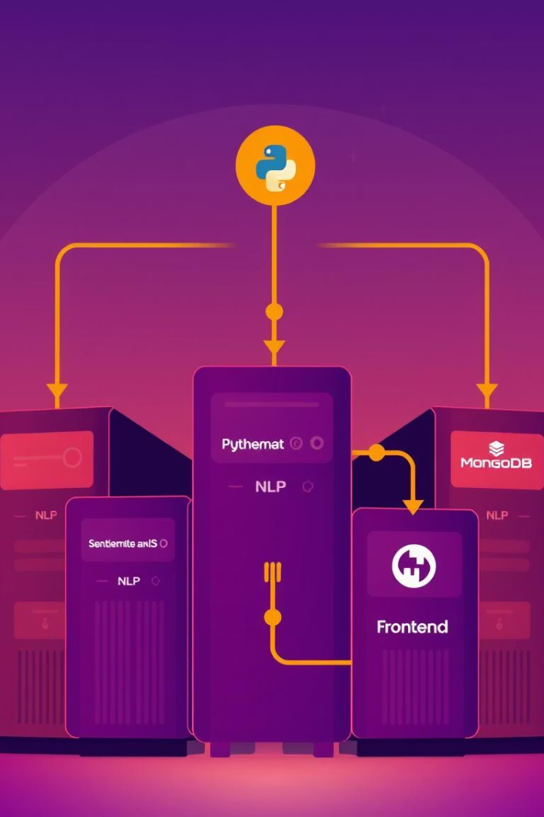
Technology Stack for Empathetic Chatbot
Core Technologies
Python forms the foundation, with NLP libraries like NLTK and spaCy for language understanding.
Sentiment Analysis
Tools like TextBlob, VADER, and BERT detect emotional tones to enable empathetic responses.
Web Framework & Storage
Flask the backend, while MongoDB securely stores user data with privacy measures.
Frontend & Security
HTML, CSS, and React create a calm interface; encryption and privacy protocols protect sensitive information.

Slide 5
Related Works and Unique Focus
Existing Chatbots
Our Distinction
Woebot and Wysa use AI and CBT principles to provide emotional support and self-help techniques.
Focuses specifically on students, addressing academic pressures and identity struggles with tailored NLP and sentiment analysis.
Research applies NLP and sentiment analysis to detect emotions and build trust in conversational AI.
Emphasizes human-centered design to resonate deeply with student experiences and provide relatable support.

Slide 6
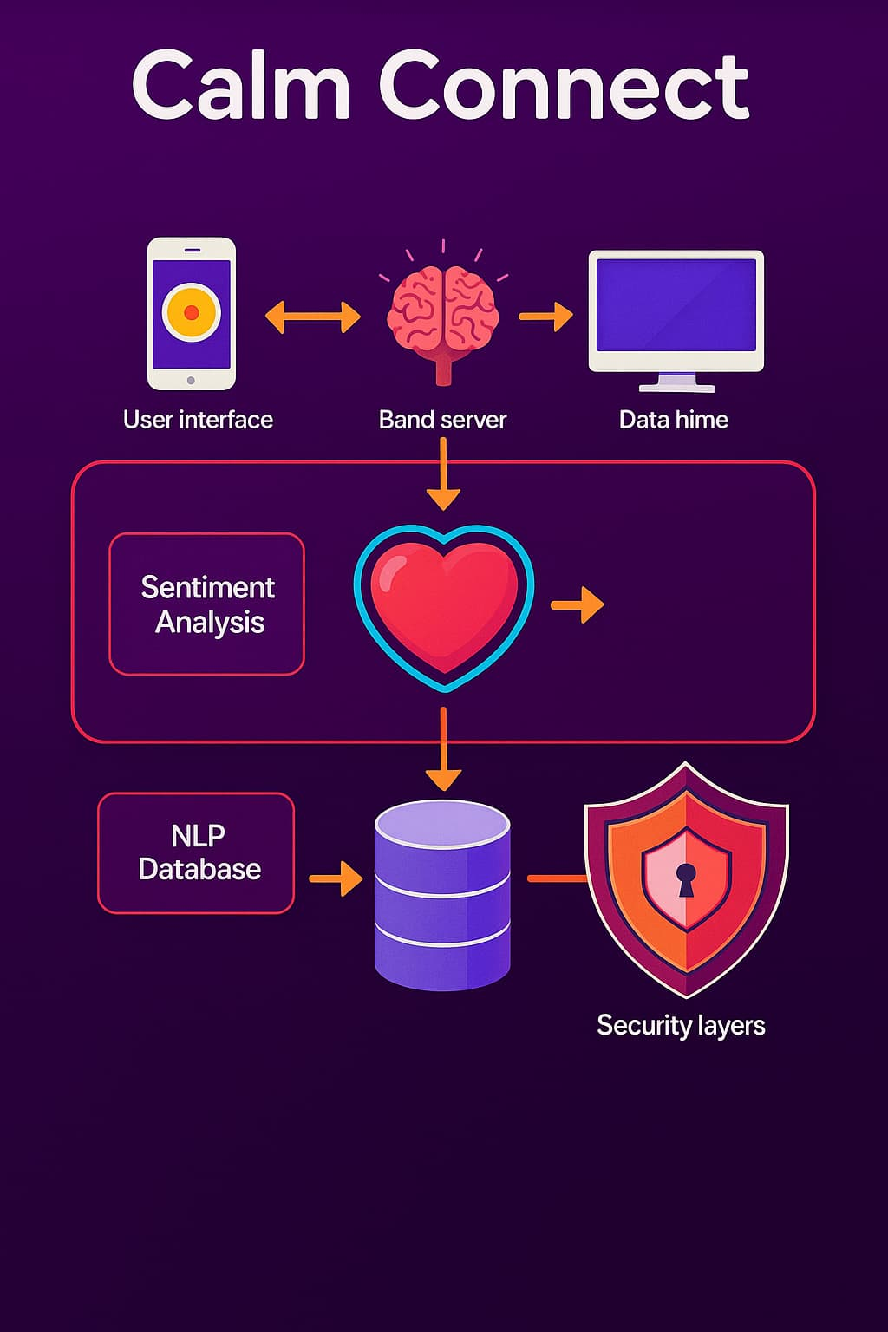




Proposed System Architecture
User Interface
Calm, welcoming web interface for students to express thoughts and emotions.
Backend Processing
Python framework handles text preprocessing, NLP, sentiment analysis, and response generation.
Data Storage & Security
MongoDB stores encrypted user data securely, ensuring privacy and session continuity.
Escalation Mechanism
Detects severe distress and suggests professional help or emergency resources with user consent.

Slide 7



AI-Based Fall Prediction and Personalized Learning
Personalized Learning
2
Tailors chatbot responses and study tips based on individual emotional state and academic pressures.
Fall Prediction
Machine learning analyses emotional patterns to forecast risk of mental health decline and intervene early.
1
Continuous Improvement
System learns from interactions to refine predictions and provide more empathetic, effective support.
3

Slide 8

System Workflow and Data Handling
1
Input Reception & Preprocessing
Student messages are tokenized, cleaned, and normalized for analysis.
2
Sentiment & Emotion Detection
Sentiment engines classify emotions to guide empathetic responses.
3
Response Generation & Fall Prediction
Chatbot replies with support and predicts emotional declines for timely intervention.
4
Data Storage & Caregiver Notification
Encrypted data stored securely; caregivers receive alerts via companion app when needed.

Slide 9

Results, Conclusion, and Future Impact
Effective Support
Privacy & Security
System provides adaptive, empathetic mental health assistance tailored to students’ needs.
Strong encryption and GDPR compliance ensure user trust and data confidentiality.
Collaborative Care
Future Potential
Companion app enables caregivers to monitor and support students proactively.
Continuous learning and cloud analytics promise improved accuracy and long-term positive impact on student well-being.

